Slide 1
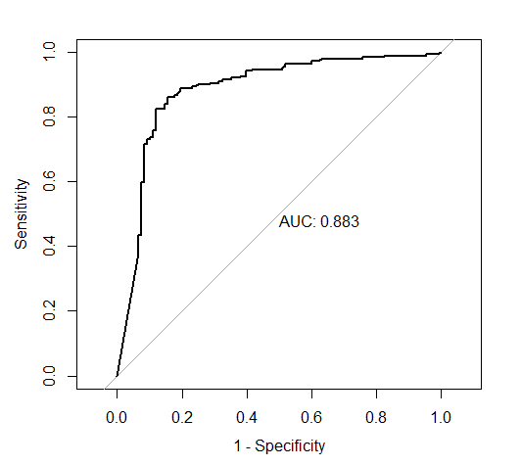
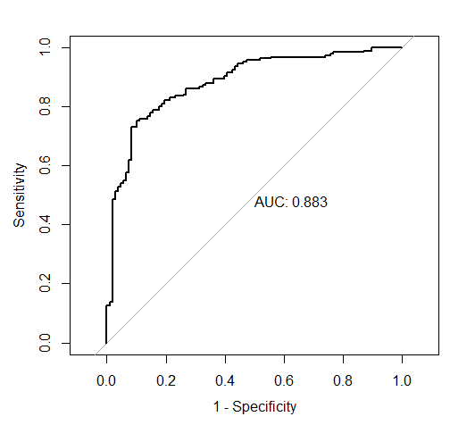
 | Registrar ALL RF | Registar ALL Logit | Registar Best RF | Registrar Best Logit | Baseline
Acc | 0.842 | 0.808 | 0.825 | 0.791 | 0.636
Kappa | 0.653 | 0.571 | 0.608 | 0.534 | 0
AUC | 0.9 | 0.879 | 0.883 | 0.883 | 0.5
Best RF:
Cut down using 1-SE rule
Only includes Cumulative GPA and P111 Grade
Best Logit:
Cut down using AIC based backwards selection and pruning based on p-values
Includes: P111 Grade, Cumulative GPA, Current number of STEM courses enrolled in, IsFirstFall, and FirstGen status
Baseline:
Guessing the mode (assumes everyone got and A or B
Registrar best RF ROC
Registrar best Logit ROC

Slide 2
 | Metric | CLASS Best Logit | CLASS Best RF | Combined Best Logit | Combined Best RF
WK1 | Acc | 0.721 | 0.737 | 0.832 | 0.805
 | Kappa | 0.319 | 0.367 | 0.636 | 0.568
 | AUC | 0.694 | 0.708 | 0.901 | 0.872
WK2 | Acc | 0.727 | 0.774 | 0.832 | 0.818
 | Kappa | 0.323 | 0.483 | 0.618 | 0.599
 | AUC | 0.768 | 0.788 | 0.909 | 0.900
WK3 | Acc | 0.768 | 0.768 | 0.849 | 0.832
 | Kappa | 0.461 | 0.474 | 0.661 | 0.629
 | AUC | 0.846 | 0.845 | 0.918 | 0.907
WK4 | Acc | 0.754 | 0.795 | 0.835 | 0.832
 | Kappa | 0.432 | 0.545 | 0.633 | 0.633
 | AUC | 0.848 | 0.849 | 0.902 | 0.902
WK5 | Acc | 0.882 | 0.882 | 0.902 | 0.882
 | Kappa | 0.738 | 0.74 | 0.788 | 0.741
 | AUC | 0.918 | 0.946 | 0.965 | 0.953
WK8 | Acc | 0.885 | 0.878 | 0.895 | 0.899
 | Kappa | 0.747 | 0.734 | 0.769 | 0.781
 | AUC | 0.966 | 0.957 | 0.966 | 0.958

Slide 3
